Slide 1
ANL488 BA Applied Project
Supervisor Meeting #2
Lim Wen Qi
China’s green finance insights from Chinese Literature: A text mining approach
Progress:
 | 10% |  | 20% |  | 30% |  | 40% |  | 50% |  | 60% |  | 70% |  | 80% |  | 90% |  | 100%

Slide 2
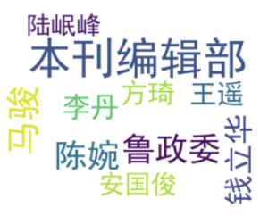
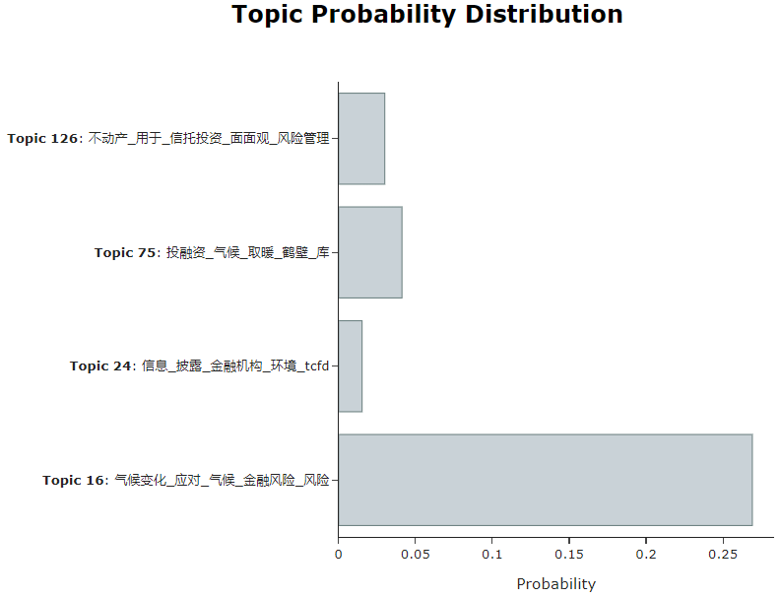
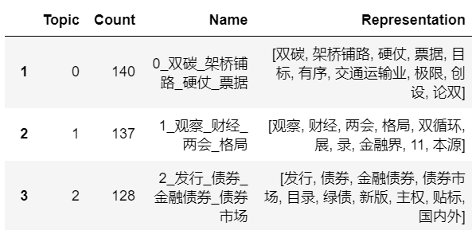
Progress Report
Progress since last meeting
Proposal Completed
Model and Visualisations Completed
Draft Slides Done

Slide 3
Updates
Goals until next meeting
Explore new finetuning adjustments using Huggingface transformers
Explore new models (ERNIE)

Slide 4
Learning
New topic modelling models (BERTopic, NMF, Top2Vec)
Learnt that embeddings, dimensional reduction tools, clustering can be used in text mining algorithms

Slide 5
Challenges
Multiple data processing issues
Challenges using LLM (OpenAI, Huggingface)
POS Tagging for finetuning makes my model worser.
Is this normal or something is wrong?

Slide 6
Concerns
Will we need to submit the coding file?
What is considered as a valid comparison?
Inside the same model: Tuning parameters of same model and analysing results?
Using different models: LDV vs BERT vs ERNIE
Some recommendations for LLM models?
Are there good LLM models that do not need API?
Any Huggingface LLM’s that are good? E.g. gpt2, flan/t5

